Slide 1
Types of Business -2
Lesson 6

Slide 2
Legal structure
Sole Trader
Partnership
Companies – private and public
Government enterprise

Slide 3
Sole Trader
A sole trader is a business that is owned by one person.
Sole Traders contribute most of the money and other resources needed to begin a business. Therefore they:
take most of the risks
stand to make all of the profit
must take most of the responsibilities for the business

Slide 4
Sole traders are commonly involved in owning small to medium business.
Although they own the business, they may employ others to help them run the business.
Sole traders may engage in a wide variety of business operations eg: rural, professionals, factories, shops, etc.
They are very common in service industries.

Slide 5
A sole trader can operate under a business name, that is different from that of the owner.
However, this name must be registered under the Business Names Act.
The owner may also incorporate his/her name into the name of his/her business.

Slide 6
The following points may limit sole traders:
Law: a sole trader may not operate a bank, building society, etc.
Licence: certain types of businesses need licenses to operate, such as hotel and taxi services.
Qualifications: professional qualifications are needed to operate as a doctor, lawyer, etc.

Slide 7
ADVANTAGES OF A SOLE TRADER BUSINESS
The owner has a great deal of control over the business (makes all the decisions).
The owner has satisfaction of developing his/her own ideas (into success)!
The owner is his/her own boss.
Since it is usually a small business the owner knows the employees and customers personally.
The owner is entitled to all profits.
It is simple to establish with no legal formalities (apart from those detailed above).
Business dealings do not have to be revealed to outsiders, except government departments.

Slide 8
DISADVANTAGES OF A SOLE TRADER BUSINESS
☒ The owner has unlimited liability for the debts.
This means that the owner is responsible for all the debts of the business. If these debts cannot be met by the business itself, then the owner may need to sell his/her private assets.
☒ The size of the business is usually restricted to the wealth of the owner.
The sole trader finances the business from savings and whatever can be borrowed. The amount of capital derived from these two sources is usually small, which makes it very difficult to expand the business, replace equipment, or cover emergencies.

Slide 9
Disadvantages cont..
The sole trader must carry out many duties in the business.
☒ Sole traders have difficulty taking holidays and sick leave, because they have problems finding someone to replace them.
☒ The success of the business is limited to the abilities and talents of the owner.

Slide 10
PARTNERSHIPS
A partnership is a business conducted in common by two or more people with a view to profit.
Generally a partnership is conducted by between 2 and 20 people.
However Legal and Medical partnerships can have 100 partners

Slide 11
The most usual form of partnership in Australia is a family partnership.
e.g a father and son/s may form a partnership to carry out their painting and decorating business ie J Artist and Sons; a brother and sister of your age may form a partnership to operate a babysitting agency.

Slide 12
In order for a partnership to operate successfully a Partnership Agreement is drawn up. This is a legally binding agreement and usually outlines:
The name and location of the business.
The nature of the business to be conducted.
The names and addresses of each partner.
The amount of capital invested by each partner.
The duties and responsibilities of each partner.
The method of sharing the profits and losses.
Decision-making procedures.
Procedures to be followed on the death or retirement of a partner.

Slide 13
When a partnership agreement is not drawn up, the Partnership Act comes into force. This basically assumes that the business is owned 50/50 and all partners can act on a given matter.
Again, a partnership may incorporate the names of the partners in its name. If it does not contain the names of all partners then it must be registered under the Business Names Act.

Slide 14
ADVANTAGES OF PARTNERSHIPS
Larger amounts of capital may be raised.
May be easier to borrow money, giving more opportunities for future expansion.
People with specialist skills may work together - wider range of skills available.
Work loads may be shared between partners.
More people to share decision making
Establishment is again simple and relatively easy.
Business dealings are confidential and need only be revealed to government departments, eg taxation. (It should be noted that, although the partnership has to send in a taxation return, it does not pay income tax. The partners have to include their share of the partnership’s profit, on their own personal tax return, (calculated with all other personal dealings.)

Slide 15
DISADVANTAGES OF PARTNERSHIPS
Partners have unlimited liability for the partnership debts.
If one partner is unable to pay his/her share (after the sale of private assets) then the other partners must cover that share also.
Partners may disagree on business related matters and make the partnership unworkable.
Partnerships generally have a limited life (because of all the hassles!).

Slide 16
COMPANIES
A company is a business, registered under a Companies Act (1989), whose capital is obtained from a number of people who buy shares in the company.
There are three main types of companies in Australia:
Public Companies – Owned by 5-infinity shareholders
Private Companies – owned by 2-50 private shareholders
No Liability Mining Companies

Slide 17
THE LIMITED LIABILITY COMPANY
Public Company
Proprietary Company
Both have limited liability.
The greatest amount investors can lose is the value of their shares. They do not lose personal assets.

Slide 18
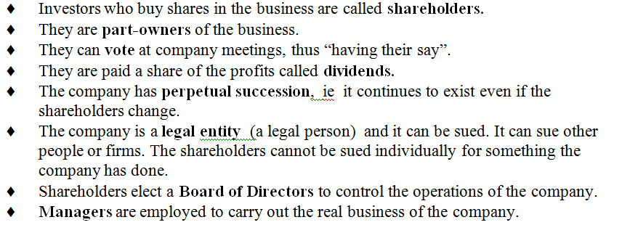
COMMON FEATURES

Slide 19
PUBLIC COMPANIES
Public Companies have a minimum of 5 shareholders, but no maximum. A shareholder is a person who owns part of the company but may not help run it.
A Board of Directors are elected by the shareholders to run the company.
The name of the company, should have LTD or Limited after its name. eg DODWELL CO LTD
Such companies may offer to sell shares to the public, ie this company raises CAPITAL from the General Public - that is, anyone from the public can become a shareholder.

Slide 20

The original cost price of the shares when they are first issued is known as the par value of the share.
This may be done through the Stock Exchange. All Public Companies are listed on the Stock Exchange and this list is available to the general public, via the local newspaper.

Slide 21
A person may enlist the services of a Stockbroker to purchase/sell shares on their behalf.
For this service, the stockbroker charges a fee/commission called brokerage.
The shareholder receives a share certificate which states the number of shares they own.

Slide 22
Companies operate all kinds of business. Because of their ability to raise funds, they are often quite large. They may have thousands of shareholders and employees.
A public company can also obtain loans from the public by issuing debentures. A debenture is a document which acknowledges a loan given to a company for a fixed period of time at a fixed rate of interest. Debenture holders are not owners of the company. They cannot vote at company meetings, as can the shareholders. They are simple owed money by the company.

Slide 23
There are strict legal requirements that these companies must meet. For example, the company must publish a COMPANY REPORT each year, in which the Managers of the company let all shareholders know how the company has progressed or performed - that is, how much profit it has made.

Slide 24
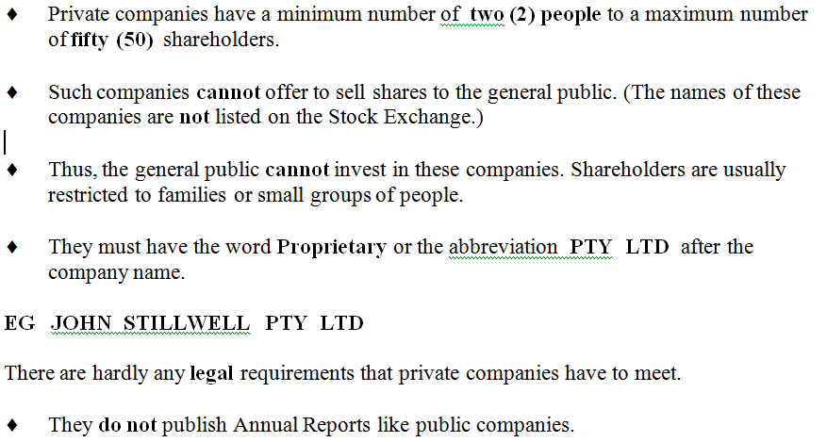
PRIVATE COMPANIES

Slide 25
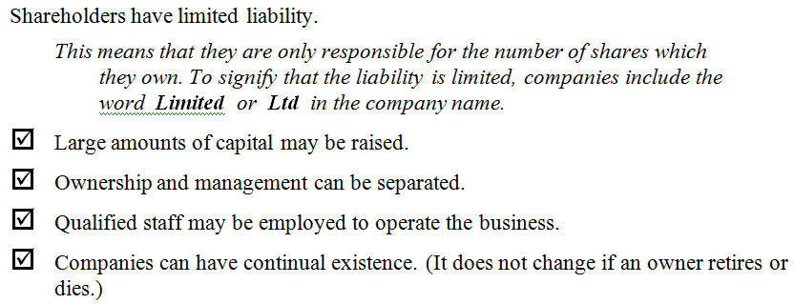
ADVANTAGES OF PUBLIC AND PRIVATE COMPANIES

Slide 26
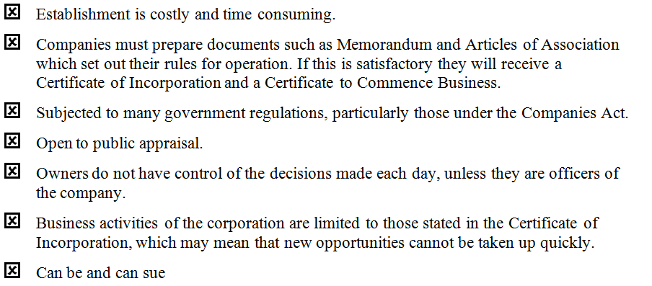
Disadvantages of Public and Private Companies

Slide 27
Handout How a Public Company is Formed
Fill in the blanks on your handout as we go.

Slide 28
HOW A PUBLIC COMPANY IS FORMED
A group of interested people (at least 5) consult a solicitor and an accountant. To incorporate, a legal process is followed.
Documents that must be drawn up include:
Memorandum of Association
Articles of Association
Prospectus
Certificate of Incorporation

Slide 29
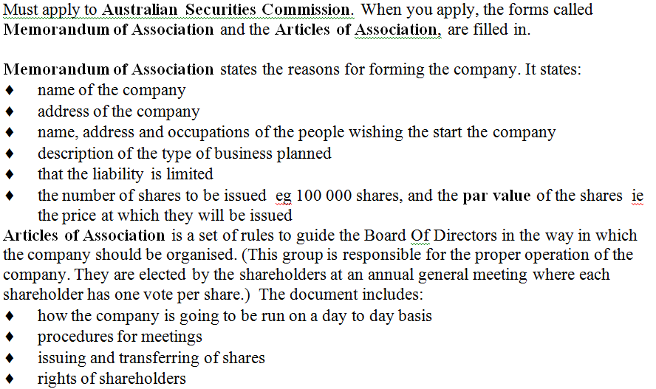
STEP 1

Slide 30
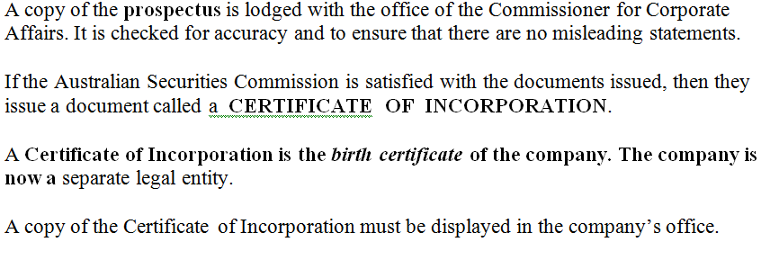
STEP 2

Slide 31
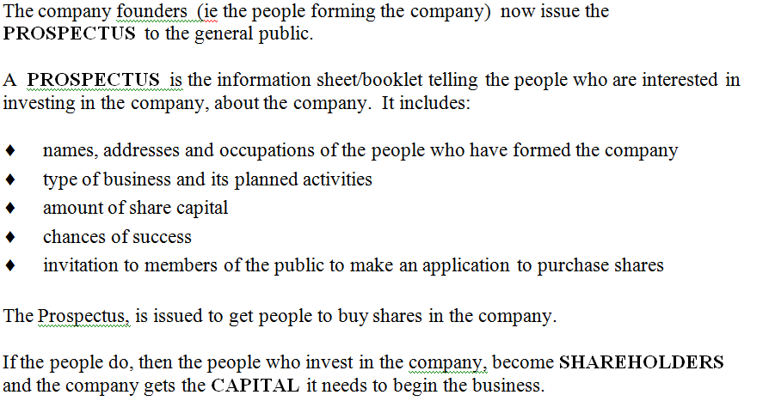
STEP 3

Slide 32
A Trust
This is a legal structure that is managed for the benefit of a beneficiary.
The Trustee Manages and makes decisions cannot benefit from the assets of the trust
Trust Deed This is a legal document that creates the trust. It sets out who are the beneficiaries, the trustees and their powers and the assets of the trust.

Slide 33
OTHER FORMS OF BUSINESS ORGANISATIONS
CO-OPERATIVES
A Co-operative is a business organisation established by a number of people with similar interests.
A co-operative is normally established as a type of limited liability company.

Slide 34
In most instances, an Act of Parliament governs the operation of co-operatives. The Act sets out such things as:
the minimum number of persons required to form a
co-operative
reporting requirements
the maximum number of shares that can be owned by any one person

Slide 35
There are two main types of co-operatives:
Producer Co-operatives
Consumer Co-operatives
There is a third type of co-operative called Financial Institution
Co-operatives.

Slide 36
PRODUCER CO-OPERATIVES
A producer co-operative is formed by suppliers wishing to produce and market a product. These are common in primary production, eg fruit growers, grain growers, fishing communities.
Producers buy shares in a co-operative and sell their goods to it. The co-operative buys each farmer’s production, to process and sell it for them.
The co-operative is run as a business, with management and staff hired to run it.

Slide 37
Such co-operatives aim to reduce costs and increase profits for growers.
Members receive dividends each year based on the quantity and quality of the products they have supplied.

Slide 38
CONSUMER CO-OPERATIVES
A consumer co-operative is formed by consumers of particular goods or services to provide a retail service to its members.
A committee is formed to run the business and staff are hired to work in the store.
Shareholders of the co-operative are either given a discount when they buy goods at the store or paid a dividend out of the profits at the end of each year.
The dividend is based on how much the shareholder has spent in the store.

Slide 39
For example, a co-operative store may purchase fruit from the market and sell it cheaply to its members.
Some producer co-operatives also operate consumer co-operative stores to provide goods and services required by farmers in the district.

Slide 40
ADVANTAGES OF PRODUCER/CONSUMER CO-OPERATIVES
In both cases, shareholding members benefit through dealings with the co-operative. Profits are distributed as dividends or bonuses or used to provide better service to the members.

Slide 41
FINANCIAL INSTITUTION CO-OPERATIVES
These co-operatives include permanent building societies and credit unions.
A permanent building society is a type of co-operative because the owners or shareholders are the customers. Customers can either invest in the society and be paid interest each year on their investment, or they can be a customer who borrows money from the society - a loan on which they pay interest.
An example is the St George Building Society (however a lot of these are now being transformed to banks).

Slide 42
A credit union is an organisation formed by a group of people with a common interest who want a place in which to put savings and from which to borrow money.
Most are formed by people who work for the same employer or who live and work in the same area.
An example is aTeacher’s Credit Union for teachers, staff, and family members. Another is the Police Credit Union.

Slide 43
FRANCHISES
A Franchise is where a business firm (called the franchisor) gives exclusive rights to a salesperson or business (called the franchisee) to sell its products in a particular area. It is very common in car sales, and service stations, which often operate under a franchise agreement.
Franchising is also common in the fast-food industry. McDonald’s, Kentucky Fried Chicken, Big Rooster and Pizza Hut are franchise businesses.
Cosmetic companies and detergent companies sometimes sell franchises to salespeople, enabling the franchisee to visit people in their own homes. Examples are Nutrimetics and Amway.

Slide 44
The company (the franchisor) provides:
the brand name
the licence to trade
help with organisation, management and staff training
advertising and promotion
the products needed for sale
The salesperson (the franchisee) provides:
their own capital
their own labour
a sum of money to the franchisor for franchise rights
(this can be a lump-sum payment and/or a set percentage of the sales)

Slide 45
Handout – fill in the gaps

